Slide 1
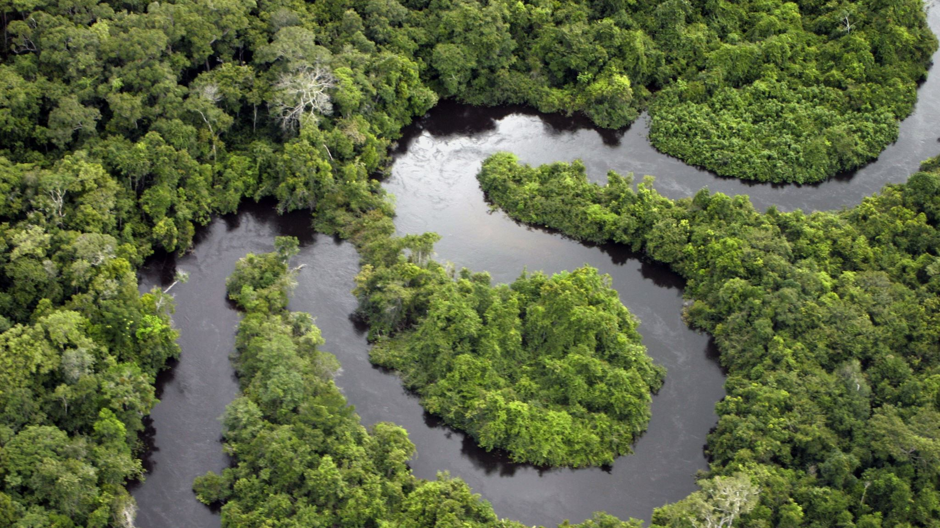
Optimizing Bioeconomy Logistics For The Amazon Region
Progress meeting: 10/06/2024
Group 6: Mamoun, Chenlu, Abdul, Mai, Mia, Bhumin

Slide 2






Overview
01
Strategies Outline
02
Data processing
And Modelling
03
List of criteria and
Supportive literature reviews
04
Next week plan

Slide 3

Work contribution
Warehouse Clustering (Incorporate OD Matrix in Warehouse Clustering)
Data Gathering and Processing
Comprehensive list of criteria to compare various transport strategies based on literature reviewed
All Members
Bhumin
Mai
Abdul
Mamoun
Chenlu
Mia

Slide 4

Strategy Outline
Modelling based on strategy

Slide 5



Strategies formation
5 Primary Aims
15 Secondary Aims
Critical Criterions setting
Feedback:
- Zero deforestation:
- Remove non-compliance strategies
- Combine similar strategies
- Literature Review
- List of comparative criteria
- Modelling
- Real World based implementation of selected strategies
Comparative criteria impact quantification
Implementation the model based on the scope set
Last Week
This Week
Next Week

Slide 6
Modelling Approaches
Method 1: Network Optimisation
Singular Algorithm to optimise all critical components
Optimisation of Time or Cost
Method 2: Sequential Optimisation
Multi-stages Algorithm
Step 1: Capacitated Facility Network Location
Step 2: Capacitated multi modal vehicle routing
Critical Components
Warehouses/Factory location
Location
Type
Served by
- Route
Optimal routes
Route types
- Modes
Mode types
Costs
Time
Monetary

Slide 7





Method-1
A systematic approach to global solutions
Warehouse Location
Mode choice
Allocation/Distribution
Consider the appropriate location and type of warehouse based on the production quantity and origin of the three products.
Selection of appropriate modes of transport for the shipment of the respective products, considering the optimization function.
Allocation of ports, warehouses and production sites
Source,
k
Mode, m
Factory,
type j at town i
Mode, n
Port,
l

Slide 8
Modelling – Mathematical Formulation

Slide 9
Modelling – Mathematical Formulation

Slide 10
Method-2
Solve the warehouse siting problem and the shortest path problem separately.
Warehouse Location
Routing Problem
Feasibility analysis
Use the weighted route distance to determine the location of warehouses, considering the warehouse types, warehouse possibility, and mode cost.
Finding the shortest paths between supply chain nodes at all echelons through capacitated vehicle routing algorithms.
Checking the feasibility of the results and reaching a final solution.

Slide 11
Modelling – Output
Step 1: Capacitated Facility Network Location
Considerations:
Generalised cost from mode type and distance Matrix
Selection of town which can have warehouse and select factory type
Outputs:
Warehouse location & type & served by
Routing & Mode for Echelon 2 (Market --> Factory)
Generalised cost for Echelon 2
Step 2: Capacitated multi modal vehicle routing
Considerations:
Generalised cost from mode type and distance Matrix
Port location
Mode types & capacity
Outputs:
Optimal route, mode type for Echelon 3 (Factory --> Port)
Generalised cost for Echelon 3

Slide 12
Data Processing
Data needed by 2 methods

Slide 13

4
Data-modes
Parameters of the available modes.
3
OD Matrix
Data Processing
Content
Using QGIS to plot distance matrices for waterways as well as roadways.
Introduces data types and their sources, data processing methods, etc.
2
Ports and Airports
Identify airports and ports where relevant products can be exported and classify them in OD matrix.
1
Production data
Filling in missing data from previous weeks processes and making predictions.

Slide 14
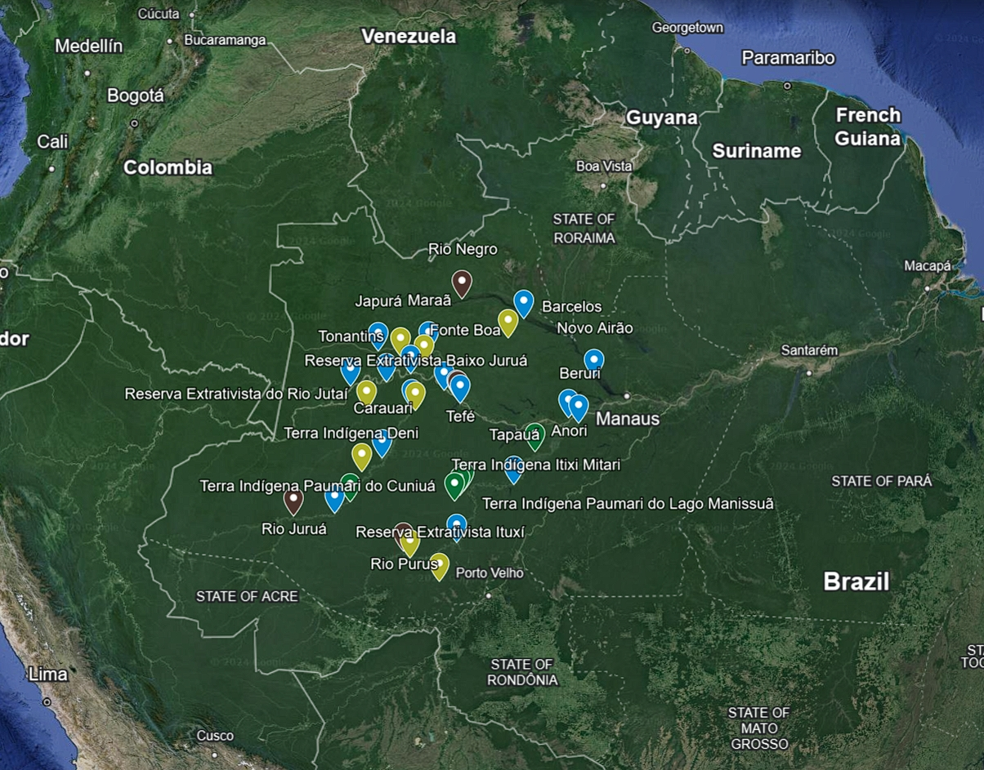
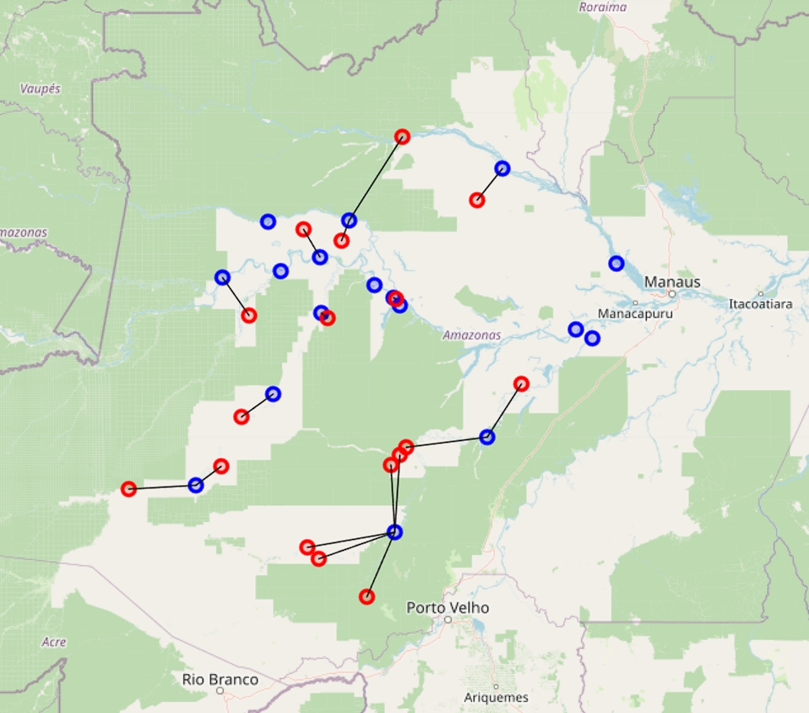
Part1: Production data – Pirarucu
Production sites:
After finding the origin of pirarucu last week, we have found the annual production of pirarucu from 2011 to 2021 and made a forecast based on the data to get the above results
Source: Conab. (2022). Boletim da Sociobiodiversidade. In.

Slide 15
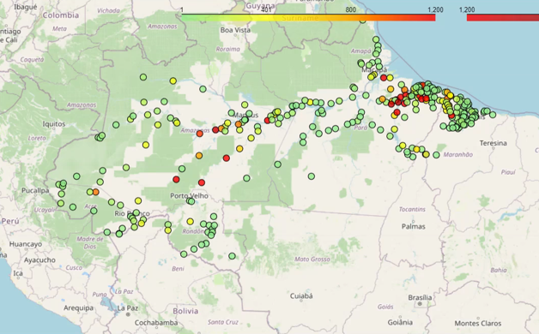
Part1: Production data – Acai Fruit
Production sites:

Slide 16
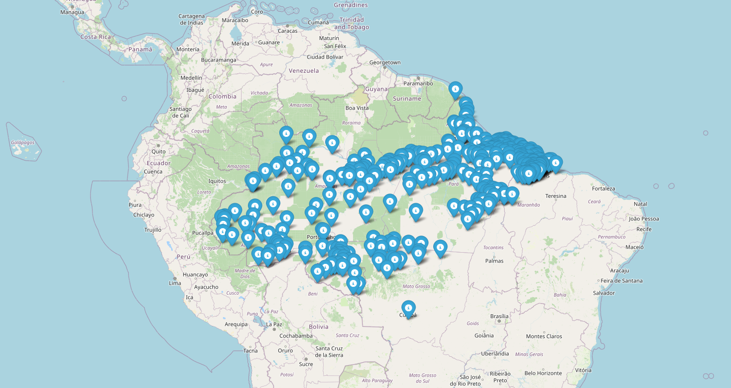
Part1: Production data – Brazil Nuts
Production sites:

Slide 17
Part1: Production data – weighting
 | unit value (USD/kg) | %
Acai | 1.13 | 31%
Brazil Nuts | 1.53 | 42%
Pirarucu | 0.97 | 27%
Source: Conab. (2022). Boletim da Sociobiodiversidade. In.
City | Latitude | Longitude | Acai Production (2022) | Brazil Nuts Production (2022) | Pirarucu Production | Score
Porto Velho | -8.7494526 | -63.873543 | 111 | 1388 | 0 | 619.578512
Nova Mamoré | -10.410486 | -65.331375 | 126 | 64 | 0 | 66.1983471
Buritis | -10.205494 | -63.828194 | 722 | 0 | 0 | 224.754821
Candeias do Jamari | -8.7949944 | -63.701885 | 3 | 2 | 0 | 1.7768595
Japurá | -1.8808469 | -66.996765 | 298 | 17 | 111 | 129.571538
Costa Marques | -12.436716 | -64.227974 | 58 | 44 | 0 | 36.600551
Guajará-Mirim | -10.780424 | -65.332779 | 573 | 775 | 0 | 505.024793
São Francisco do Guaporé | -12.060998 | -63.56683 | 7 | 3 | 0 | 3.44352617
Cacaulândia | -10.338004 | -62.900723 | 38 | 0 | 0 | 11.8292011
Vale do Anari | -9.8580809 | -62.174141 | 34 | 0 | 0 | 10.584022
Jaru | -10.431826 | -62.478767 | 40 | 0 | 0 | 12.4517906
Ji-Paraná | -10.877815 | -61.927784 | 0 | 35 | 0 | 14.7520661
Ouro Preto do Oeste | -10.717914 | -62.25666 | 9 | 0 | 0 | 2.80165289
Maraã | -1.8535579 | -65.589775 | 84 | 3 | 295 | 106.123591
Presidente Médici | -11.168664 | -61.905762 | 0 | 2 | 0 | 0.84297521

Slide 18
4
Data-modes
Parameters of the available modes.
3
OD Matrix
Data Processing
Content
Using QGIS to plot distance matrices for waterways as well as roadways.
Introduces data types and their sources, data processing methods, etc.
2
Ports and Airports
Identify airports and ports where relevant products can be exported and classify them in OD matrix.
1
Production data
Filling in missing data from previous weeks processes and making predictions.

Slide 19
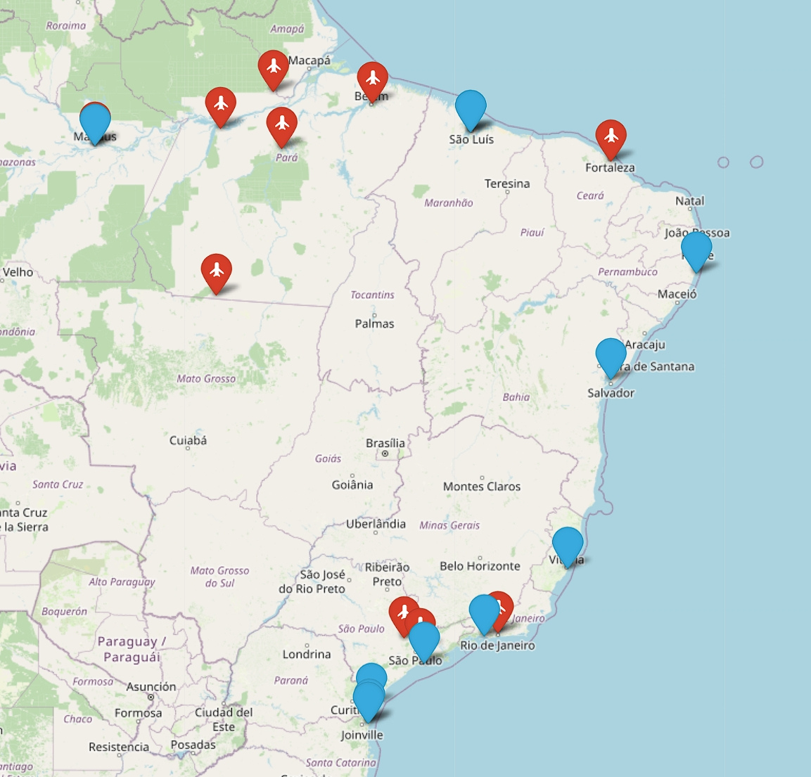
Part2: Ports and airports that can be used for export
Type | Name | Latitude | Longitude | Product Type | Capacity (tonnes per year)
Port | Porto de Santos | -23.9659 | -46.3019 | bulk cargo (grain and sugar) | >50,000,000
 | Porto de Paranaguá | -25.5183 | -48.5075 | grain, sugar and coffee | 60,000,000 (grain: 45,000,000)
 | Porto de Rio Grande | -32.1100 | -52.0971 | grain and meat | >40,000,000 (grain:25,000,000)
 | Porto de Itaqui | -2.5632 | -44.3659 | grain | >30,000,000(grain:25,000,000)
 | Porto de Suape | -8.3939 | -34.9780 | liquid and solid bulk | >20,000,000(liquid:10,000,000)
 | Porto de Vitória | -20.3155 | -40.3388 | grain, sugar and coffee | >10,000,000
 | Porto de Aratu | -12.7778 | -38.5225 | liquid bulk (biofuels and fertilisers) | >10,000,000
 | Porto de Manaus | -3.1390 | -60.0245 | products from the Amazon | 2,000,000
 | Porto de Itapoá | -26.1155 | -48.6132 | bulk agricultural products | 1,500,000 TEUs
 | Porto de São Francisco do Sul | -26.2390 | -48.6342 | grain and timber | >13,000,000 (grain: >8,000,000)
 | Porto de São Luís | -2.5632 | -44.3659 | grain | >25,000,000 (grain: 20,000,000)
 | Porto de Itaguaí | -22.9326 | -43.8225 | grain and biofuels | 10,000,000 + 20,000,000
Airport | BRGIG - Internacional de Galeao | -22.8123 | -43.2510
 | BRSTM - Santarem | -2.4247 | -54.7858
 | BRMEU - Monte Dourado Airport | -0.8882 | -52.5995
 | BRBEL - Val De Cans Intl (Belem) | -1.3822 | -48.4767
 | BRITB - Cachimbo | -9.3339 | -54.9651
 | BRVCP - Internacional de Campinas/Viracopos | -23.0074 | -47.1433
 | BRGRU - Internacional de Sao Paulo - Guarulhos | -23.4290 | -46.4794
 | BRMAO - Internacional Eduardo Gomes | -3.0321 | -60.0465
 | BRATM - Altamira | -3.2531 | -52.2487
 | Pinto Martins – Fortaleza International Airport | 3.7756 | -38.5326 | Fruit and Fish | 70,000

Slide 20
4
Data-modes
Parameters of the available modes.
3
OD Matrix
Data Processing
Content
Using QGIS to plot distance matrices for waterways as well as roadways.
Introduces data types and their sources, data processing methods, etc.
2
Ports and Airports
Identify airports and ports where relevant products can be exported and classify them in OD matrix.
1
Production data
Filling in missing data from previous weeks processes and making predictions.

Slide 21

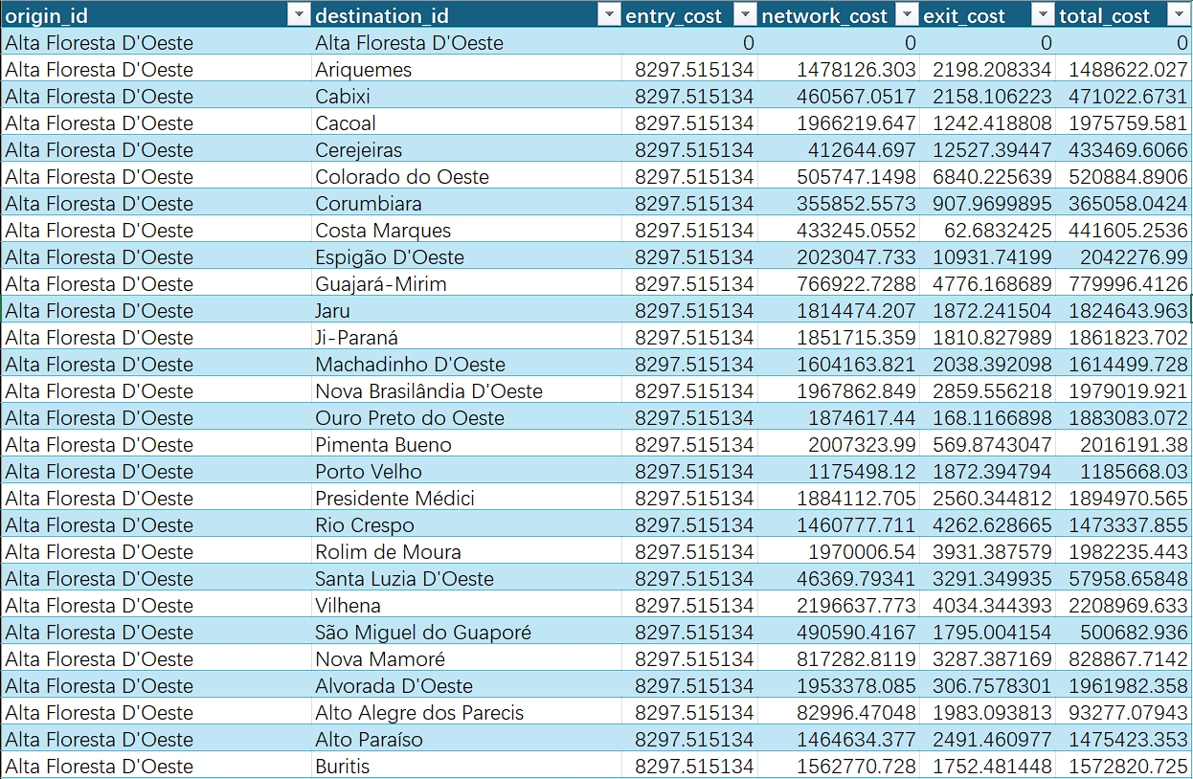
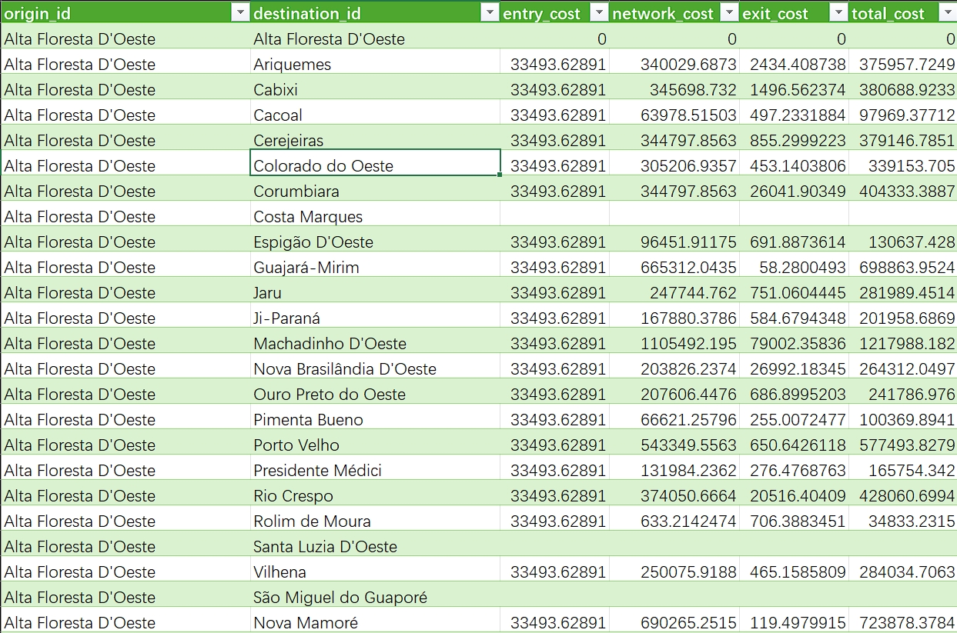
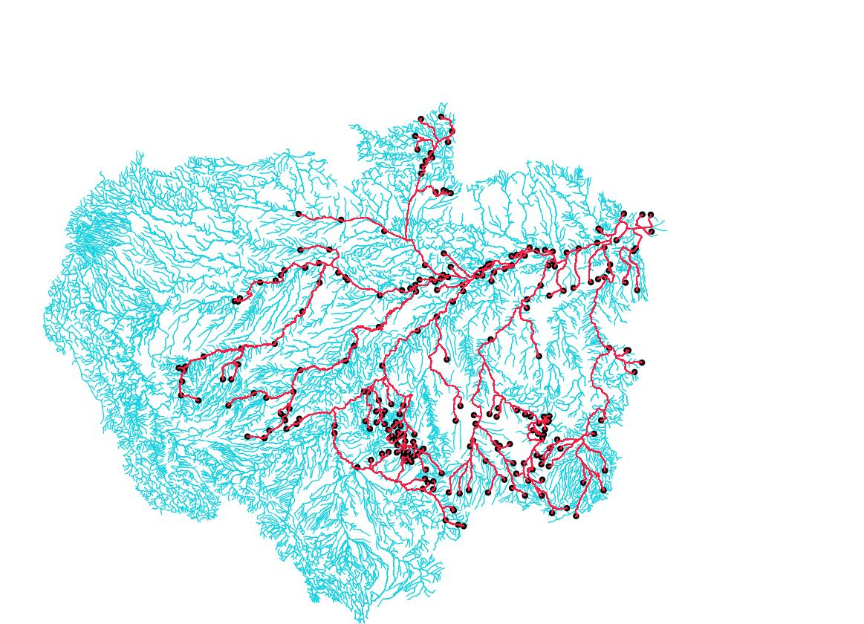
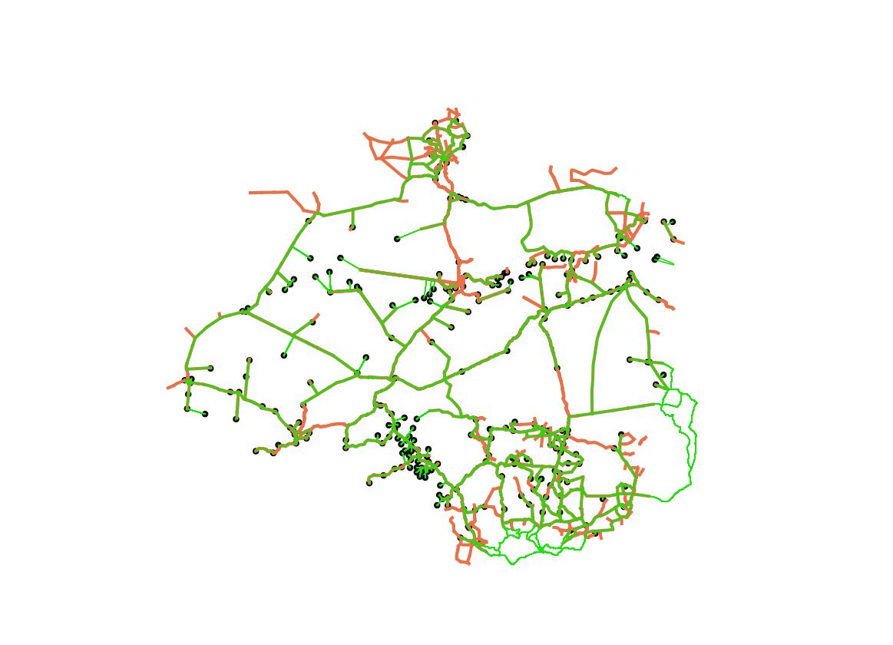

Part 3: OD Matrix
Waterway
Highway
Sales
Source: Instituto Brasileiro de Geografia e Estatística
Source: Ministério dos Transportes
2014 Highway, Town, Existing Highway, Shortest Path
Waterway, Town, Existing Waterway, Shortest Path

Slide 22
4
Data-Modes
Parameters of the available modes.
3
OD Matrix
Data Processing
Content
Using QGIS to plot distance matrices for waterways as well as roadways.
Introduces data types and their sources, data processing methods, etc.
2
Ports and Airports
Identify airports and ports where relevant products can be exported and classify them in OD matrix.
1
Production data
Filling in missing data from previous weeks processes and making predictions.

Slide 23
Part 4: Data – Modes
Mode |  | Capacity (tons) | Initial Cost | Cost of shipping (per ton per km) | Speed (km/h) | Emission (kg CO2 per ton per km) | Job Creation
Water | Freezer Boat | 32 | $3,790,000.00 | $0.04350 | 18.4 | 0 | 50
 | Ferry with Freezer | 125 | $600,000.00 | $0.12500 | 20 | 0.108 | 15
 | Mid Size ferry | 150 | $2,000,000.00 | $0.04350 | 21 | 0.108 | 15
 | Large ferry | 900 | $4,000,000.00 | $0.04350 | 21 | 0.108 | 15
 | River Barges | 3500 | $1,250,000.00 | $0.03000 | 12 | 0.108 | 15
 | Voadeiras | 0.3 | $17,500.00 | $0.30000 | 34 | 0.081 | 13
Road | Refrigerator truck (Mercedes-Benz Actros, Volvo FH with refrigerated body) | 18 | $150,000.00 | $3.00 | 80 | 0.071 | 5
 | Pickup Truck (Toyota Hilux, Ford Ranger) | 1.25 | $32,500.00 | $2.50 | 65 | 0.215 | 5
 | Vans (Mercedes-Benz Sprinter) | 5 | $30,000.00 | $1.25 | 70 | 0.107 | 5
 | Normal Truck (Volvo FMX, MAN TGS) | 22.5 | $100,000.00 | $1.75 | 80 | 0.047 | 5
Air | Medium Propeller Planes (ATR 42) | 5 | $1,200,000.00 | $3.0323 | 450 | 0.448 | 14
 | Large Cargo Planes (Boeing 737-400 Freighter) | 20 | $15,000,000.00 | $3.0323 | 800 | 0.378 | 20
 | Helicopters (Sikorsky S-76) | 0.6 | $0.60 | $3.60 | 250 | 4.2 | 9
Train | Standard Cargo Train | 7000 | $2,000,000.00 | $0.020 | 60 | 0.26 | 43
 | Refrigerated Cargo | 7000 | $5,000,000.00 | $0.0350 | 60 | 0.299 | 43

Slide 24
Literature Review
Literature reviews on criteria used in assessing Acai, Brazil nuts and Pirarucu transportation strategies

Slide 25

Literature Review
Energy Efficiency
Construction
and
Maintenance
Cost
Electrification and renewables in Amazon transport minimize emissions and promote sustainability.
Energy
Efficiency
Digital Access
Enhancing Amazon's digital infrastructure boosts logistics efficiency, and sustainability.
Construction and Maintenance Cost
Developing Amazon infrastructure is costly due to terrain and weather; using existing rivers reduces costs and maintains efficiency.
Potential for
Volume
Growth
Potential for Volume Growth
Criteria 1-5
Scalable transport for the Amazon bioeconomy requires enhanced waterway capacity and frequent, quality product transport.
Job Creation
Developing transportation infrastructure in the Amazon boosts jobs and GDP through sustainable practices like zero deforestation.
Digital
Access
Job
Creation

Slide 26
Literature Review
Environmental Impact
Environmental
Impact
Sustainable Amazon transport focuses on reducing pollution and protecting biodiversity through electric and waterway modes.
Safety and
Security
Sensitivity to Climate events
The Amazon's climate challenges transportation, particularly for perishables, requiring consistent conditions despite weather disruptions.
Safety and Security
To ensure the safety of bioeconomy products and infrastructure, robust security measures, comprehensive safety regulations, and extensive training are essential to mitigate risks from theft, damage, disasters, and cyberattacks.
Criteria 6-9
Community Engagement
Successful Amazon transportation projects require engaging local communities to ensure cultural respect, economic benefits, and sustainable development, focusing on key criteria such as energy efficiency, security, and infrastructure resilience.
Sensitivity to
Climate events
Community
Engagement

Slide 27
Next Week Plan

Slide 28
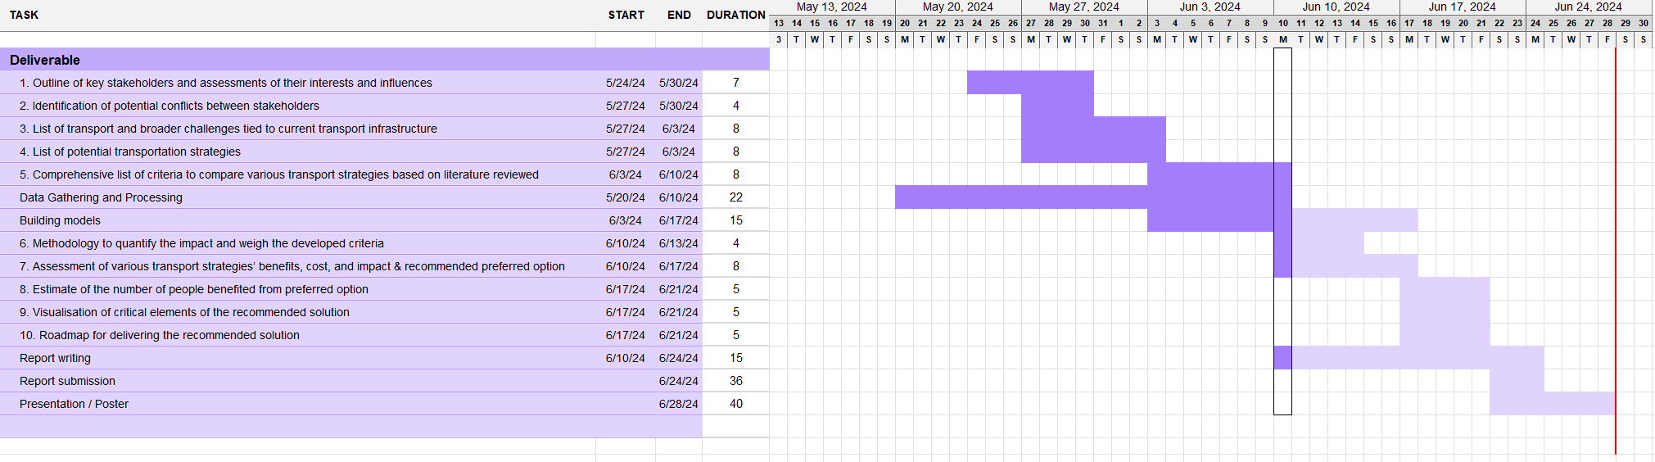
Project Plan

Slide 29
THANK YOU

